Slide 1
ML model for analyzing 2D image in medical problems
Yang Liu

Slide 2
Import data
we could import the data from Zenodo
https://zenodo.org/record/6496656#.YnH2F-jMJD8

Slide 3
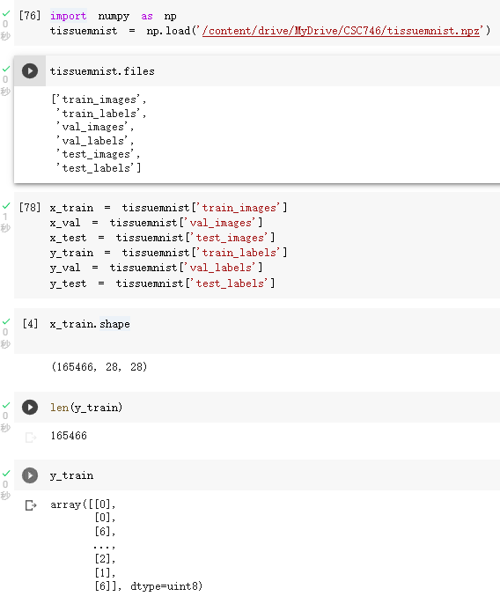
Dataset tissuesmnist
In tissuesmnist, there are 6keys:
'train_images', 'train_labels', 'val_images', 'val_labels', 'test_images', 'test_labels'
WE can use .shape and len() to get the pixel of image and the number of y_train
236,386 samples
165,466 train_image; 8 class
23,640 validation_image
47,280 test_image

Slide 4
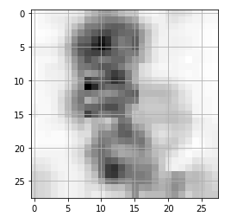
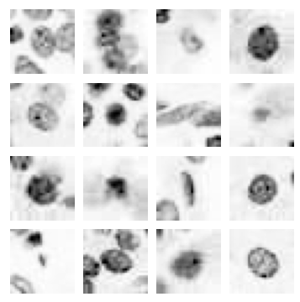
Show the image by using the matplotlib:
x_train[1]
As we can see, the image is not clear.
x_train[i]
i=0-16

Slide 5
Pre-pocess:
1.Reshape
from 28*28 to 784
2.Normalization
Use MinMaxScaler
3.ONE HOT

Slide 6
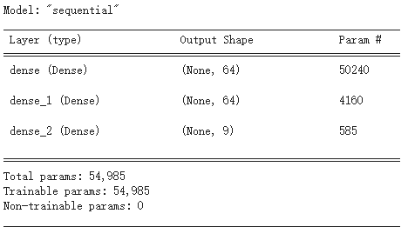
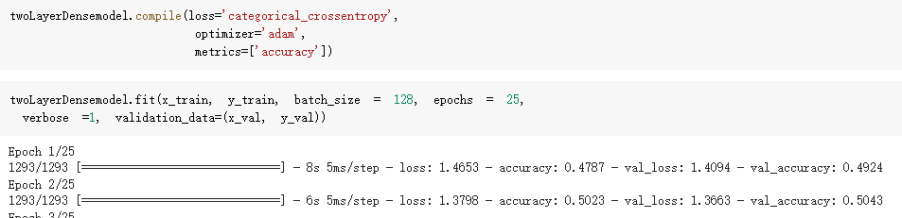

2 Layer CNN:
Structure
Some parameters
Accuracy:

Slide 7
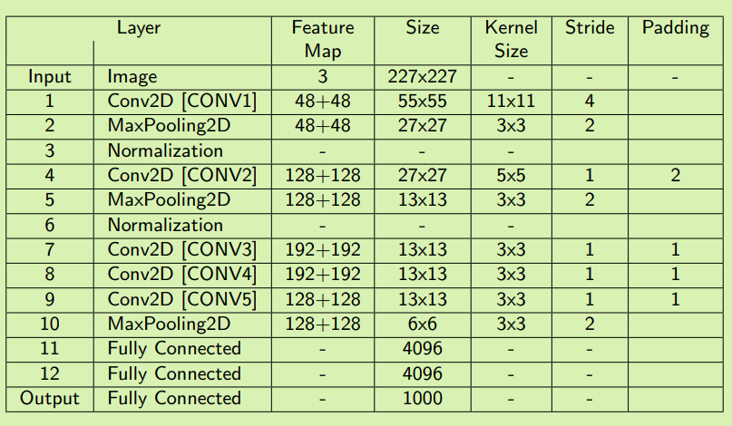
AlexNet:
It is the original AlexNet structure, and the image is 227*227 ; however, My image is 28*28
So, I change the kernel_size from 11*11 to 3*3

Slide 8
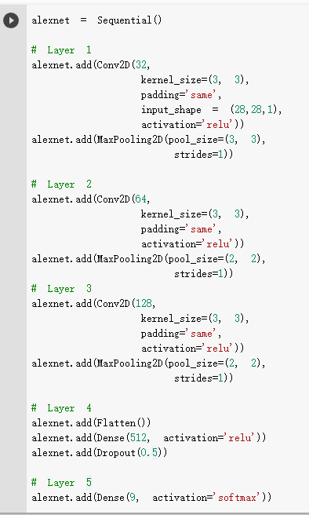
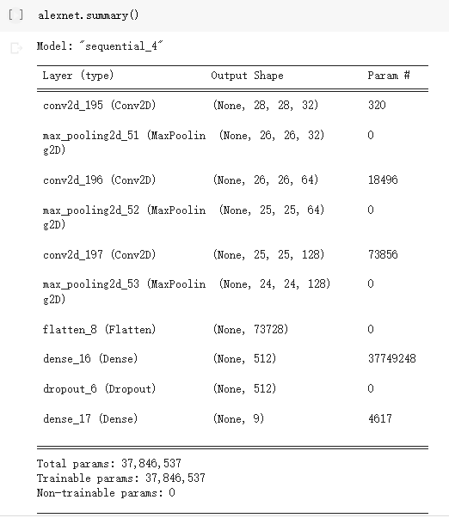
AlexNet:

Slide 9
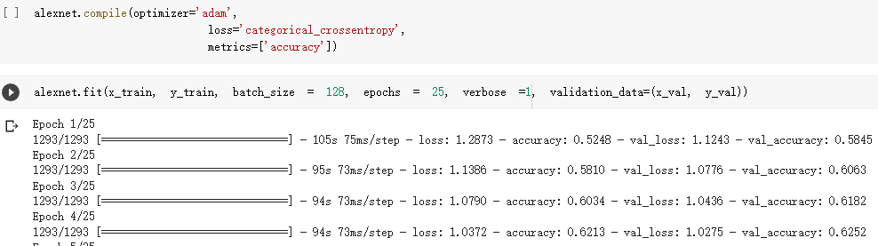

AlexNet:

Slide 10
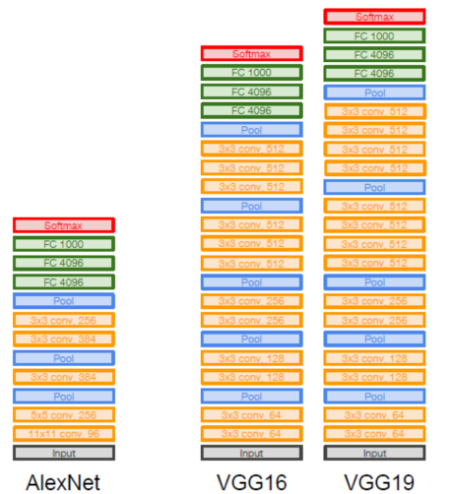
Comparing to the AlexNet, VGGNet is much deeper networks and with much smaller filters, increasing the number of layers to 16 and 19 layers
VGGNet19:

Slide 11
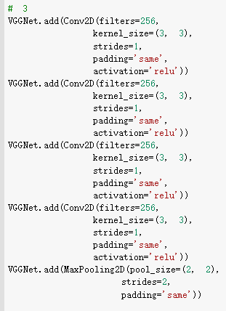
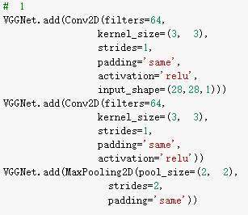
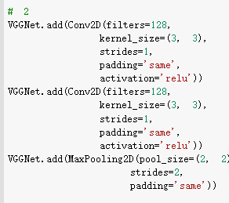
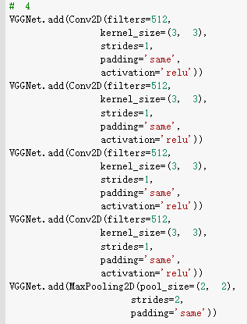
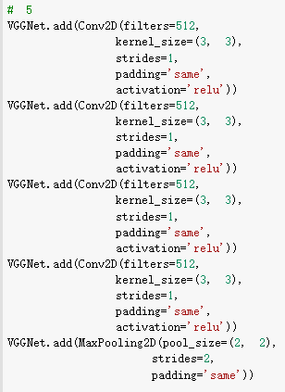

VGGNet19:

Slide 12
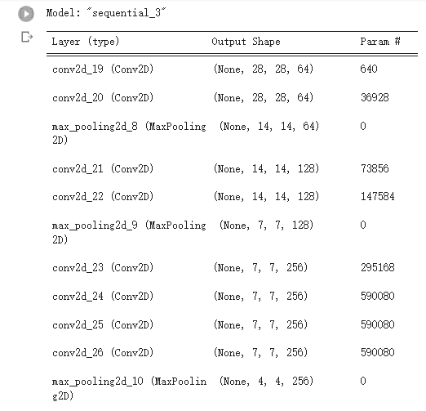
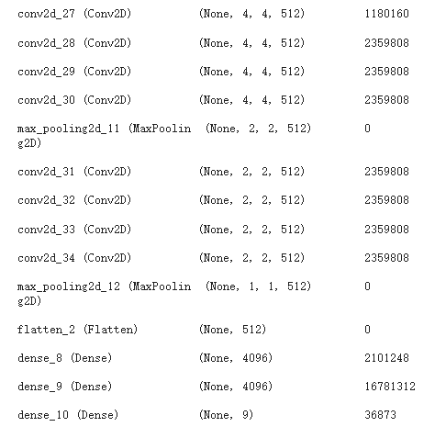
VGGNet19:
Structure

Slide 13
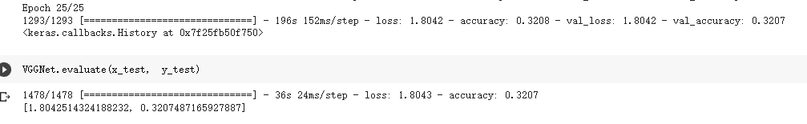
VGGNet19:

Slide 14
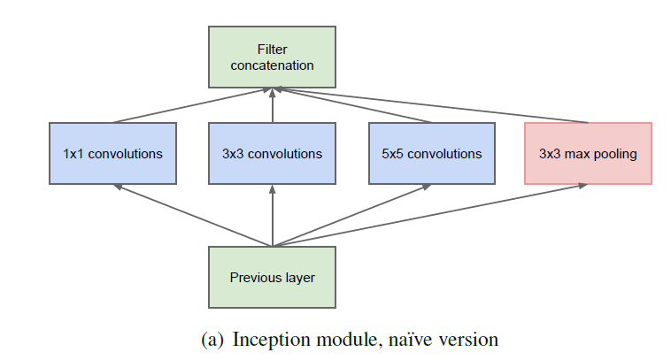
GoogleNet:
Inception module: design a good local network topology(network within a network) and then stack these modules on top of each other

Slide 15
GoogleNet:

Slide 16
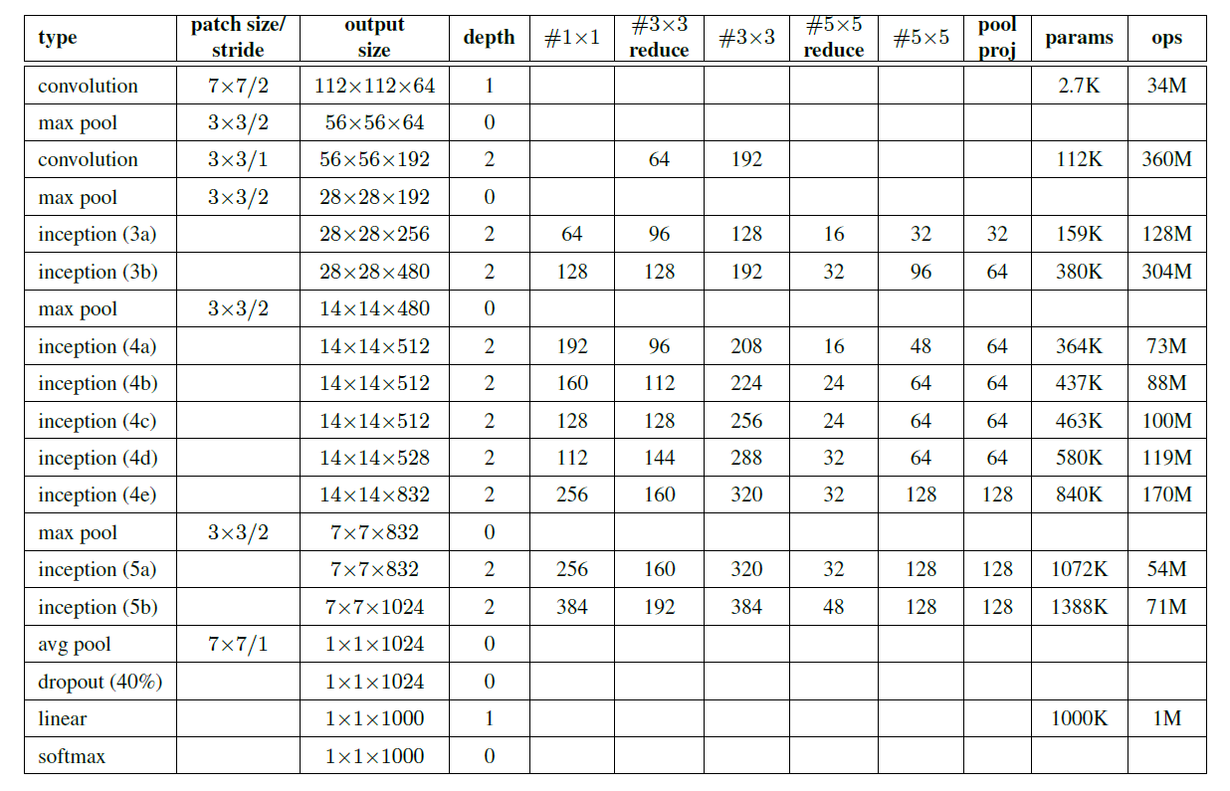
GoogleNet:

Slide 17
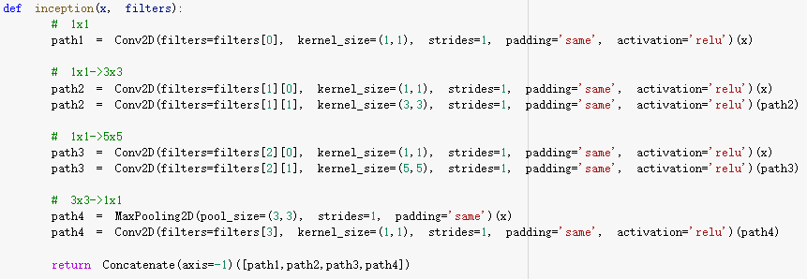
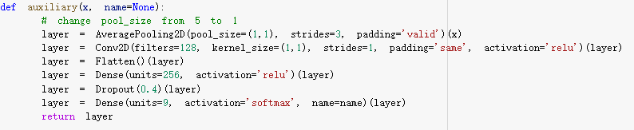
GoogleNet:

Slide 18
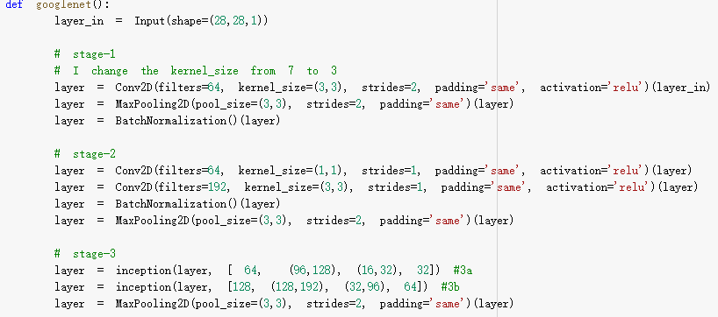
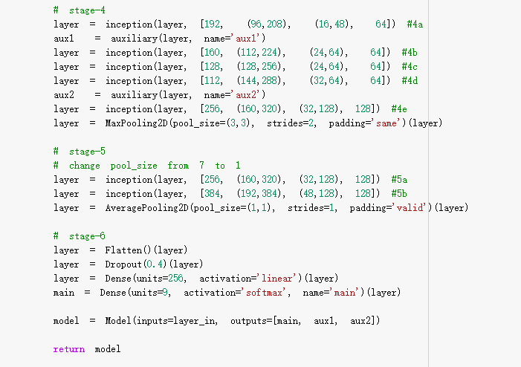
GoogleNet:

Slide 19
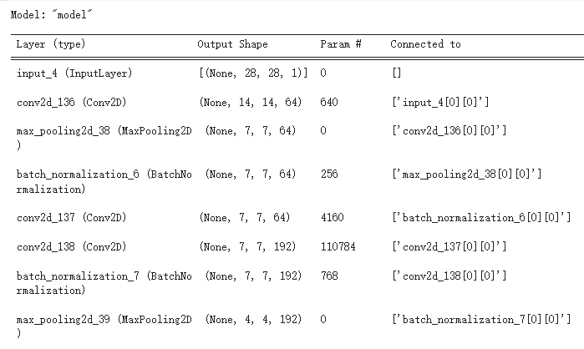
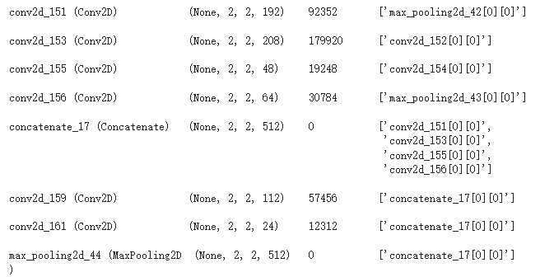
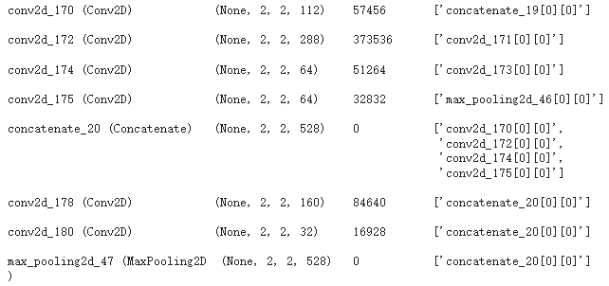
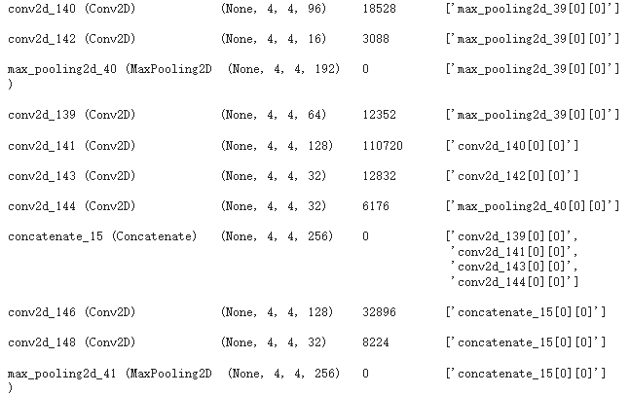
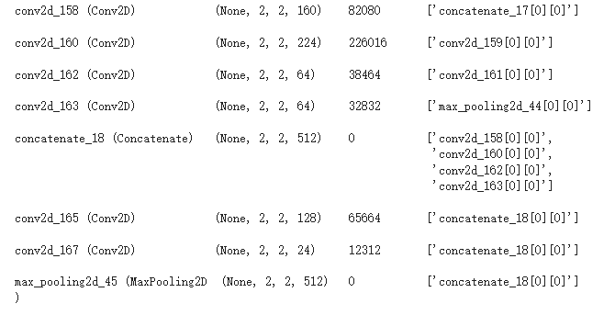
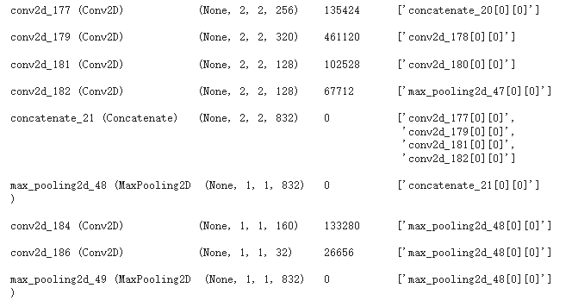
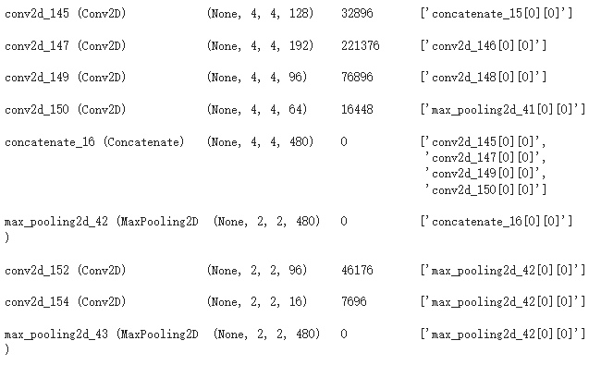
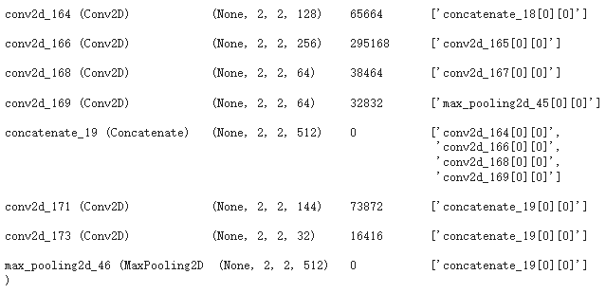

GoogleNet:
Structure

Slide 20
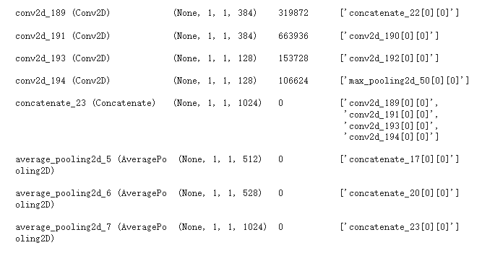
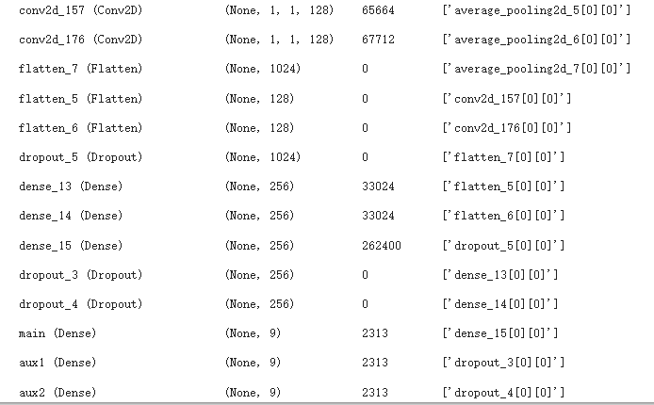
GoogleNet:

Slide 21
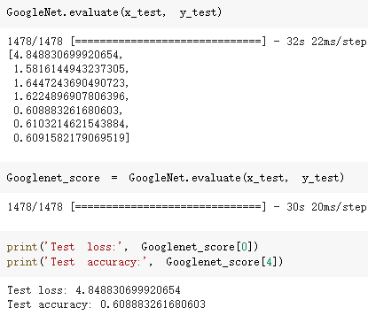
GoogleNet:

Slide 22
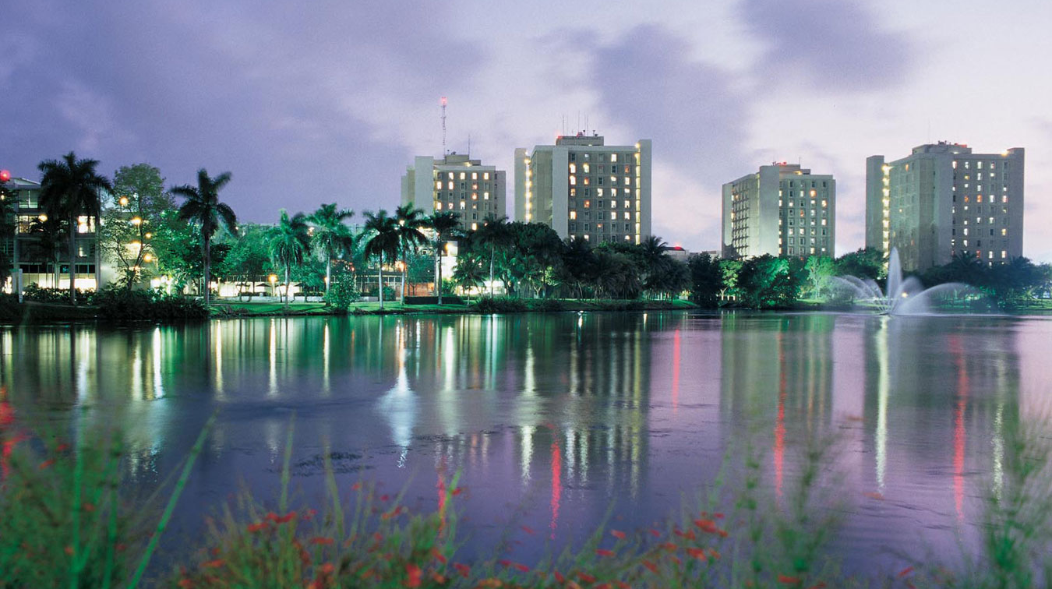
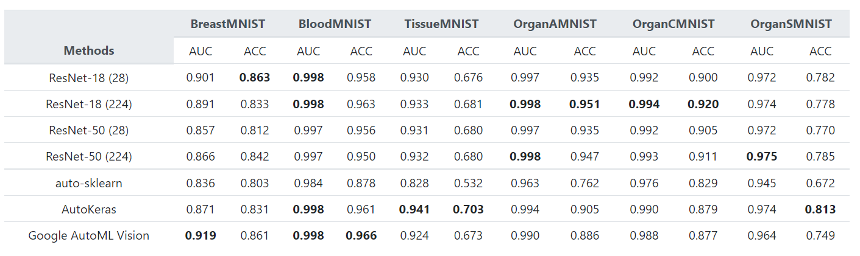
Conclusion
.

Slide 23
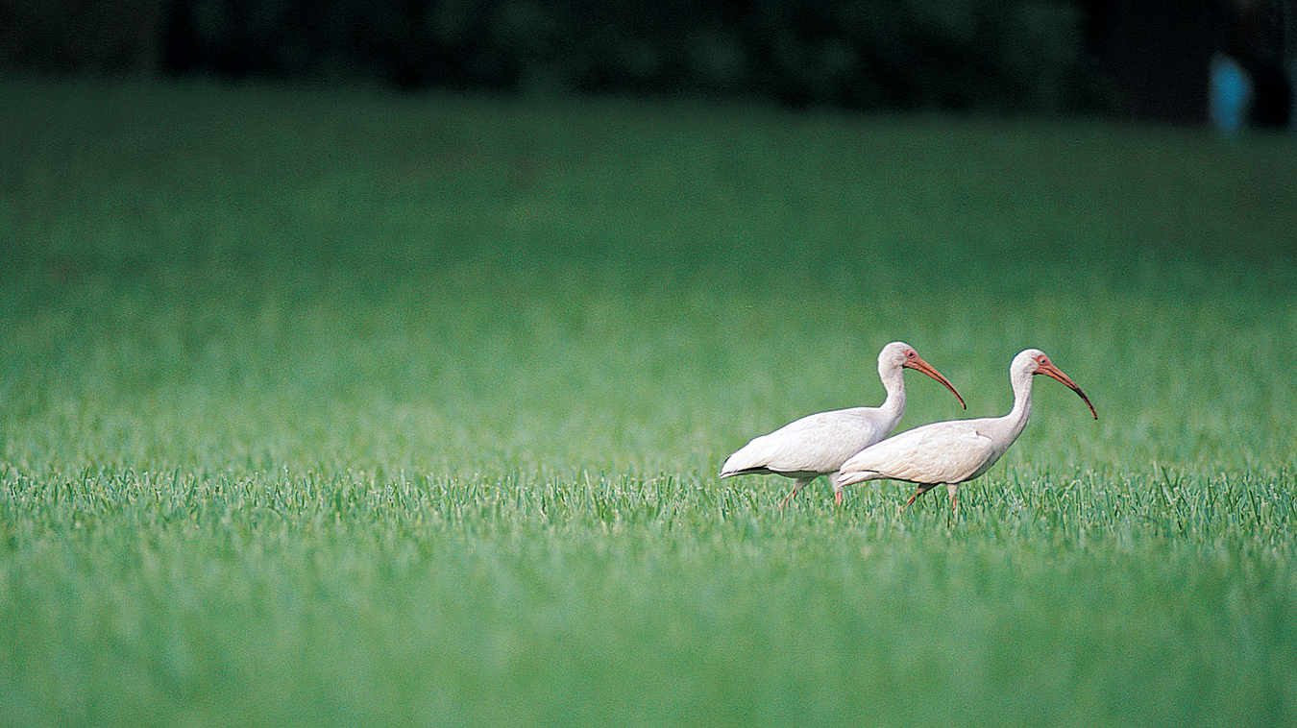
Thank you!

